Slide 1
Unit 1
Introduction, basics and writing program
Introduction, need for scala, scala REPL, data types, scala variables and data types, option type, Type inference, Getting familier with Idea Intellij, how to install scala plugnins, build tools:Maven and SBT, download dependencies, write scala program, compiling , building and running program using console, Intellij setting and preferences, learn shortcuts, Debugging your code.

Slide 2
Unit 2
Scala loops, conditional statement, collections and exception handling
Scala Loops:-scala for and scala while, conditional expressions, scala array and scala tuples etc. Scala Collections:-Immutable collections and mutable collections like list, set and map, break statement, scala comments, scala string, string methods, string interpolation. Scala Exception Handling:-try-catch block, finally block, throw keyword, throws keyword, scala custom exception.
Unit 3
Scala object oriented programing and file handling
Scala oops concepts:class and objects, singleton and companion objects, case class and objects, scala constructors, scala functions, scala method overloading and overriding, scala final. scala inheritance, scala Trait, scala trait mixins, scala complete program with case class and File handling in scala.
Unit 4
Functional programming, Asynchronous programing and some iMPORTANT topics ALONG WITH TESTING.
Functional and asynchronous programing in scala, Higher order functions, covariance, scala varrargs, pattern matching in scala, Implicit types, working with GitHub, Testing your functionalities with test cases.

Slide 3
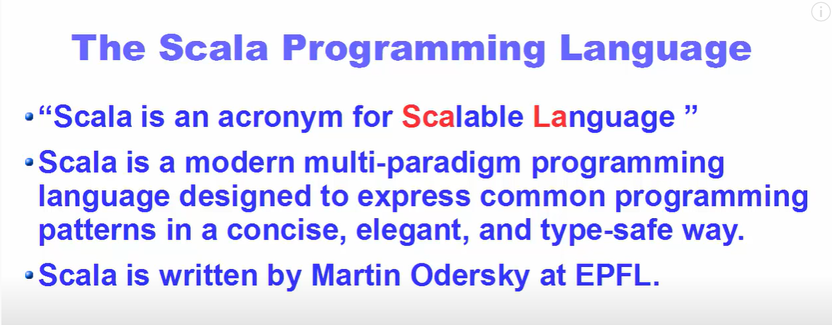

Slide 4
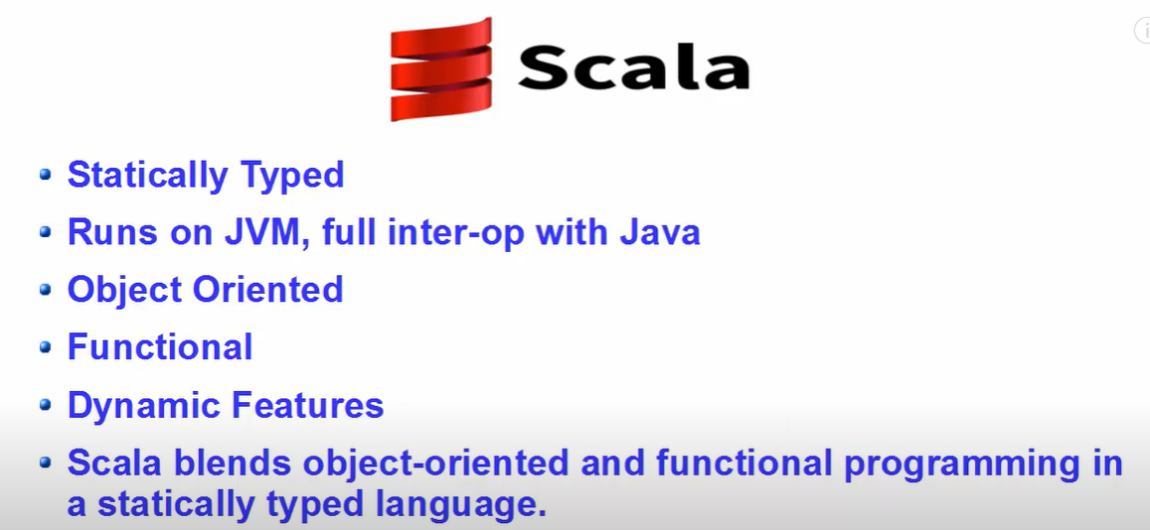

Slide 5
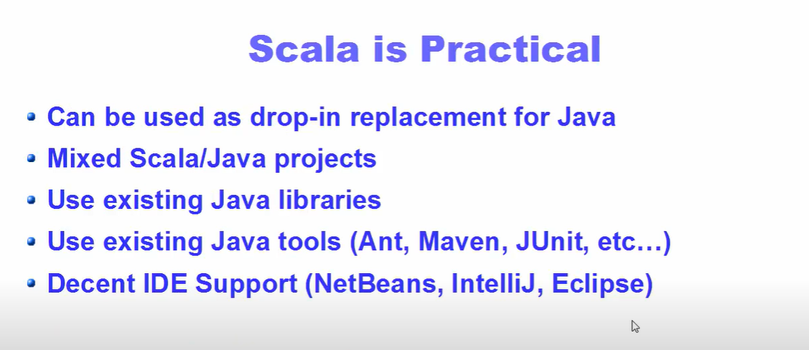

Slide 6
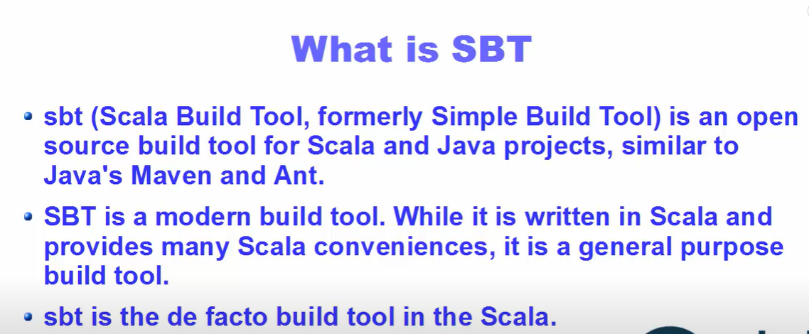

Slide 7
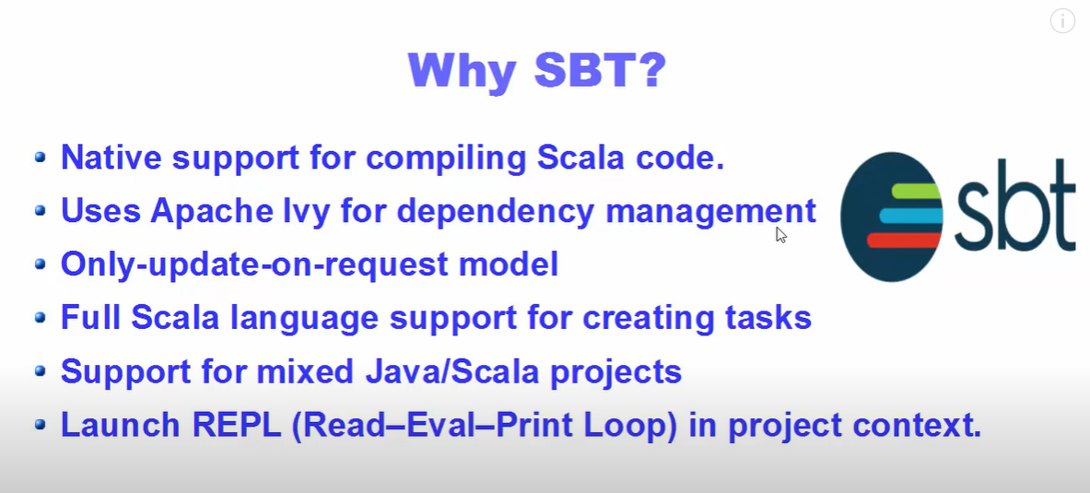

Slide 8
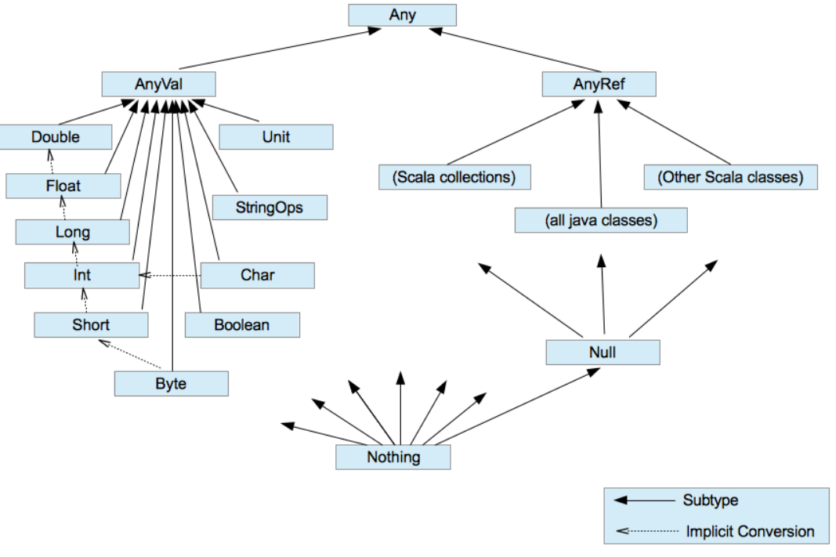

Slide 9
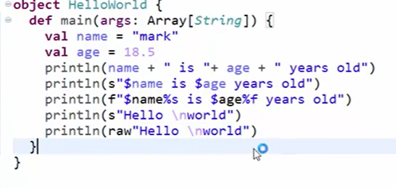
String Interpolation
String not safe interpolation
Type safe interpolation Because we will provide data types itself.
Raw Interpolation

Slide 10
An iterator is a way to access elements of a collection one-by-one. It resembles to a collection in terms of syntax but works differently in terms of functionality. An iterator defined for any collection does not load the entire collection into the memory but loads elements one after the other. Therefore, iterators are useful when the data is too large for the memory. To access elements we can make use of hasNext() to check if there are elements available and next() to print the next element.
object Scala_Iterator {
def main(args: Array[String]): Unit = {
val v = Iterator(5, 1, 2, 3, 6, 4)
//checking for availability of next element
while(v.hasNext)
//printing the element
println(v.next)
}
}

Slide 11
We can define an iterator for any collection(Arrays, Lists, etc) and can step through the elements of that particular collection.
object Scala_Iterator_for_any_collection {
def main(args: Array[String]): Unit = {
val v = Array(5,1,2,3,6,4)
//val v = List(5,1,2,3,6,4)
// defining an iterator
// for a collection
val i = v.iterator
while (i.hasNext)
print(i.next + " ")
}
}

Slide 12
Scala Collection
Scala provides rich set of collection library. It contains classes and traits to collect data. These collections can be mutable or immutable. we can use them according to your requirement. Scala.collection.mutable package contains all the mutable collections. You can add, remove and update data while using this package.
Scala.collection.immutable contains all the immutable collections. It does not allow you to modify data. Scala imports this package by default. If you want mutable collection, you must import scala.collection.mutable package in your code.
Scala Collections
Scala Collection
ScalaSet
Scala HashSet
Scala BitSet
Scala ListSet
Scala Seq
Scala Vector
Scala List
Scala Queue
Scala Stream
Scala Maps
Scala Hash
MapScala
ListMap

Slide 13
Scala Set
It is used to store unique elements in the set. It does not maintain any order for storing elements. You can apply various operations on them. It is defined in the Scala.collection.immutable package.
Scala Set Syntax
val variableName:Set[Type] = Set(element1, element2,... elementN) or
val variableName = Set(element1, element2,... elementN)

Slide 14
object Scala_Collections_Set {
def main(args: Array[String]): Unit = {
val set1 = Set() // An empty set
val Mtech_Stu_Names = Set("Somesh","Kapil","Brijneder","Ritika","Tosseb") // Creating a set with elements
val Mtech_Stu_Names1:Set[String] =Set("Somesh","Kapil","Brijneder","Ritika","Tosseb")
println(set1)
println("First way to Defined Set:="+Mtech_Stu_Names)
println(s"Second way to Defined Set:=$Mtech_Stu_Names1")
// println(Mtech_Stu_Names.head) // Returns first element present in the set
// println(Mtech_Stu_Names.tail) // Returns all elements except first element.
// println(Mtech_Stu_Names.isEmpty) // Returns either true or false
}

Slide 15
Scala Set Example: Merge two Set
we can merge two sets into a single set. Scala provides a predefined method to merge sets. In this example, ++ method is used to merge two sets.
object Scala_Collections_Set_Mearge_Two_Set
{
def main(args: Array[String]): Unit =
{
val name = Set("kapil","somesh","rohit","mohit")
val rollnumber = Set("101","102","103","104","105")
val mergeSet = name ++ rollnumber // Merging two sets
println("Elements in games set: "+name.size) // Return size of collection
println("Elements in alphabet set: "+rollnumber.size)
println("Elements in mergeSet: "+mergeSet.size)
println(mergeSet)
}
}

Slide 16
Scala Set Example: Adding and Removing Elements
object Scala_Collection_Set_Add_Remove
{
def main(args: Array[String]): Unit =
{
var Mtech_Stu_Name=Set("mk","jk","tk","np")
// Mtech_Stu_Name.foreach((name:String)=>println(name))
Mtech_Stu_Name -= "makhan"
Mtech_Stu_Name.foreach((name:String)=>println(name))
}
}

Slide 17
Iterating Set Elements using foreach loop
object Scala_Collection_Iterating_elements_Foreach {
def main(args: Array[String]): Unit = {
var Mtech_Stu_names = Set("Somesh", "Rohit", "Kapil", "Mukesh")
Mtech_Stu_names.foreach((element:String)=> println(element))
}
}
Iterating Set Elements using for loop =?

Slide 18
Scala HashSet
HashSet is sealed class. It extends immutable Set and AbstractSet trait. Hash code is used to store elements. It neither sorts the elements nor maintains insertion order . The Set interface implemented by the HashSet class, backed by a hash table . In Scala, A concrete implementation of Set semantics is known HashSet.
Scala HashSet Example
In the following example, we have created a HashSet to store elements. Here, foreach is used to iterate elements.
import scala.collection.immutable.HashSet
object Scala_Collection_HashSet {
def main(args: Array[String]): Unit = {
var Mtech_Stu_Name = HashSet("kapil","somesh","rohit","mohit","xyz")
Mtech_Stu_Name.foreach((name:String)=>println(name+" "))
// Mtech_Stu_Name.foreach((element:String) => println(element+" "))
}
}

Slide 19
Operations perform with HashSet
Adding an elements in HashSet : We can add an element in HashSet by using + sign. below is the example of adding an element in HashSet.
Adding more than one element in HashSet : We can add more than one element in HashSet by using ++ sign. below is the example of adding more than one elements in HashSet.
Remove element in HashSet : We can remove an element in HashSet by using – sign. below is the example of removing an element in HashSet.
Find the intersection between two HashSets : We can find intersection between two HashSets by using & sign. below is the example of finding intersection between two HashSets.

Slide 20
Scala Seq
Seq is a trait which represents indexed sequences that are guaranteed immutable. we can access elements by using their indexes. It maintains insertion order of elements.
Sequences support a number of methods to find occurrences of elements or subsequences. It returns a list.
object Scala_Collection_Seq { def main(args: Array[String]): Unit = { var Roll_number:Seq[Int] = Seq(52,85,1,8,3,2,7) Roll_number.foreach((element:Int) => print(element+" ")) println("\nAccessing element by using index") println(Roll_number(2)) } }

Slide 21
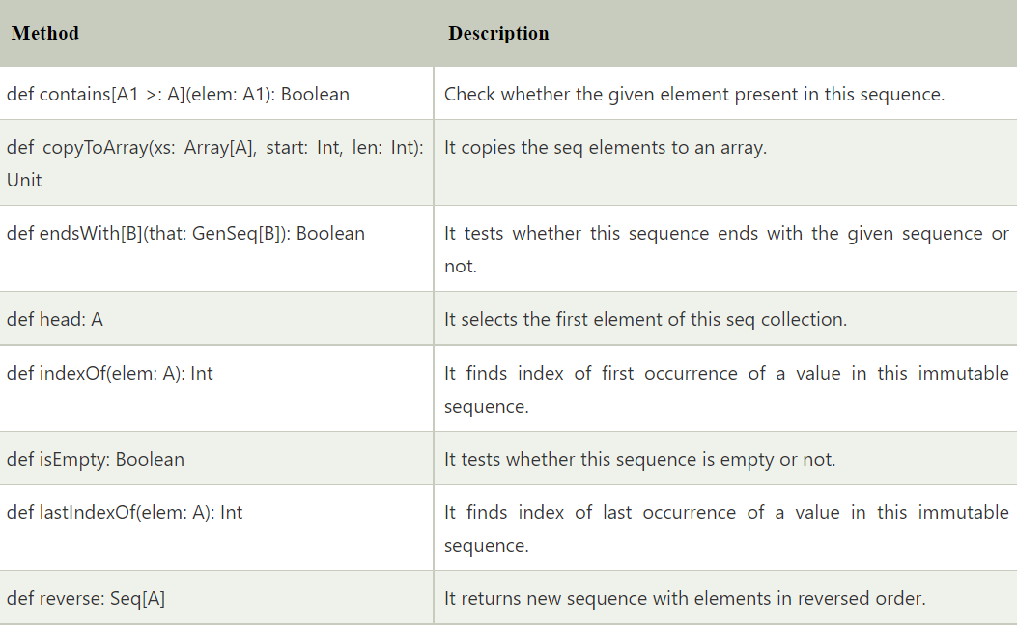
Commonly used Methods of Seq
object Scala_Collection_Seq_Methods { def main(args: Array[String]): Unit = { var seq:Seq[Int] = Seq(52,85,1,8,3,2,7) seq.foreach((element:Int) => print(element+" ")) println("\nis Empty: "+seq.isEmpty) println("Ends with (2,7): "+ seq.endsWith(Seq(2,7))) println("contains 8: "+ seq.contains(8)) println("last index of 3 : "+seq.lastIndexOf(3)) println("Reverse order of sequence: "+seq.reverse) } }

Slide 22
Scala List
List is used to store ordered elements. It extends LinearSeq trait. It is a class for immutable linked lists. This class is good for last-in-first-out (LIFO), stack-like access patterns.
It maintains order of elements and can contain duplicates elements also.
object Scala_Collection_List {
def main(args: Array[String]): Unit = {
// List of Strings
var list = List(“mohit“,”Xyz”)
// List of Integer
var list2:List[Int] = List(1,8,5,6,9,58,23,15,4)
// Empty List.
// Two dimensional list
val dim: List[List[Int]] =
List(
List(1, 0, 0),
List(0, 1, 0),
List(0, 0, 1)
)
println(list)
println(list2)
println(dim)
}
}
Scala Lists
Lists are immutable whereas arrays are mutable in Scala.
Lists represents a linked list whereas arrays are flat.

Slide 23
All lists can be defined using two fundamental building blocks, a tail Nil and ::, which is pronounced cons. Nil also represents the empty list. All the above lists can be defined as follows.
object Scala_Collection_List1 {
def main(args: Array[String]): Unit = {
// List of Strings
val Stu_name = "Kapil" :: ("Mohit" :: ("Shaifali" :: Nil))
// List of Integers
val Roll = 1 :: (2 :: (3 :: (4 :: Nil)))
// Empty List.
val empty = Nil
// Two dimensional list
val dim = (1 :: (0 :: (0 :: Nil))) ::
(0 :: (1 :: (0 :: Nil))) ::
(0 :: (0 :: (1 :: Nil))) :: Nil
print(Stu_name)
print(dim)
}
}

Slide 24
Basic Operations on Lists
All operations on lists can be expressed in terms of the following three methods.
Sr.No | Methods & Description
1 | head This method returns the first element of a list.
2 | tail This method returns a list consisting of all elements except the first.
3 | isEmpty This method returns true if the list is empty otherwise false.
object Scala_Collection_List_Operations {
def main(args: Array[String]): Unit = {
val Stu_name = "x" :: ("y" :: ("z" :: Nil))
val Stu_nums = Nil
println( "Head of fruit : " + Stu_name.head )
println( "Tail of fruit : " + Stu_name.tail )
println( "Check if fruit is empty : " + Stu_name.isEmpty )
println( "Check if nums is empty : " + Stu_nums.isEmpty )
}
}

Slide 25
Concatenating Lists
we can use either ::: operator or List.:::() method or List.concat() method to add two or more lists. Please find the following example given below −
object Scala_Collection_List_Concat {
def main(args: Array[String]): Unit = {
val Stu_name = "x" :: ("y" :: ("z" :: Nil))
val Stu_Stream = "Mtech" :: ("Msc" :: Nil)
// use two or more lists with ::: operator
var all_info = Stu_name ::: Stu_Stream
println( "Stu_name ::: Stu_Stream : " + all_info )
// use two lists with Set.:::() method
all_info = Stu_name.:::(Stu_Stream)
println( "Stu_name.:::(Stu_Stream) : " + all_info )
// pass two or more lists as arguments
all_info = List.concat(Stu_name, Stu_Stream)
println( "List.concat(Stu_name, Stu_Stream) : " + all_info )
}
}

Slide 26
Creating Uniform Lists
we can use List.fill() method creates a list consisting of zero or more copies of the same element. Try the following example program.
object Scala_Collection_List_Uniform {
def main(args: Array[String]): Unit = {
val Stu_name = List.fill(3)("Rohit") // Repeats apples three times.
println( "Stu_name : " + Stu_name )
val num = List.fill(10)(2) // Repeats 2, 10 times.
println( "num : " + num )
}
}

Slide 27
Tabulating a Function
we can use a function along with List.tabulate() method to apply on all the elements of the list before tabulating the list. Its arguments are just like those of List.fill: the first argument list gives the dimensions of the list to create, and the second describes the elements of the list. The only difference is that instead of the elements being fixed, they are computed from a function.
Try the following example program.
Example

Slide 28
Scala functions are first class values. Difference between Scala Functions & Methods: Function is a object which can be stored in a variable. But a method always belongs to a class which has a name, signature bytecode etc. Basically, we can say a method is a function which is a member of some object.
object Scala_Class_Function {
def main(args: Array[String]): Unit = {
val myGetAreaFn= (rad:Double) =>
{
val PI =3.14
PI * rad*rad
}
println(myGetAreaFn(2.2))
}
}
Class scala_class_methods {
def mygetareamd(rad:double):double=
{
Val pi =3.14
PI* rad* rad
}
}
Object scala_class_methods_obj
{
Def main(args: array[string]): unit = {
val m1= new scala_class_methods()
Println(m1.Mygetareamd(2.2))
}
}

Slide 29
Scala Queue
Queue implements a data structure that allows inserting and retrieving elements in a first-in-first-out (FIFO) manner.
In scala, Queue is implemented as a pair of lists. One is used to insert the elements and second to contain deleted elements. Elements are added to the first list and removed from the second list.
import scala.collection.immutable._ object Scala_Collection_Queue { def main(args: Array[String]): Unit = { var queue = Queue(1,5,6,2,3,9,5,2,5) var queue2:Queue[Int] = Queue(1,5,6,2,3,9,5,2,5) println(queue) println(queue2) } }
import scala.collection.immutable._ object Scala_Collection_Queue_Methods { def main(args: Array[String]): Unit = { var queue = Queue(1,5,6,2,3,9,5,2,5) print("Queue Elements: ") queue.foreach((element:Int)=>print(element+" ")) var firstElement = queue.front print("\nFirst element in the queue: "+ firstElement) var enqueueQueue = queue.enqueue(100) print("\nElement added in the queue: ") enqueueQueue.foreach((element:Int)=>print(element+" ")) var dequeueQueue = queue.dequeue print("\nElement deleted from this queue: "+ dequeueQueue) } }

Slide 30
Scala Set map() method
The map() method is utilized to build a new set by applying a function to all elements of this set.
Method Definition: def map[B](f: (A) => B): immutable.Set[B]
object Scala_Collection_Maps_new {
def main(args: Array[String]): Unit = {
// Creating a set
val s1 = Set(5, 1, 3, 2, 4)
// Applying map method
// val result = s1.map(x => x*x)
val result1 = s1.map(x => x+2)
// Display output
// println(result)
println(result1)
}
}

Slide 31
Scala Map
Map is a collection of key-value pairs. In other words, it is similar to dictionary. Keys are always unique while values need not be unique. Key-value pairs can have any data type. However, data type once used for any key and value must be consistent throughout. Maps are classified into two types: mutable and immutable. By default Scala uses immutable Map. In order to use mutable Map, we must import scala.collection.mutable.Map class explicitly.
How to create Scala Maps
object scala_collection_maps {
def main(args: array[string]): unit = {
// var name:vector[string] = vector("kapil","somesh","rohit","mohit") //or
// var rollnumber = vector(101,102,103,104,105)
var name =map((1,"kapil"),(2,"somesh"))
// another way
var name2 = map(3->"somesh",4->"ball")
var newmap = name2+(5->"xyz") // adding a new element to map
var removeelement = newmap-4 // // removing an element from map
println(name)
println(name2)
println(newmap)
println(removeelement)
}
}

Slide 32
Operations on a Scala Map
There are three basic operations we can carry out on a Map:
keys: In Scala Map, This method returns an iterable containing each key in the map.
values: Value method returns an iterable containing each value in the Scala map.
isEmpty: This Scala map method returns true if the map is empty otherwise this returns false.
object Scala_Collection_Map_Accessing {
def main(args: Array[String]): Unit = {
var name2 = Map(3->"somesh",4->"Ball")
// Accessing score of Ajay
val Three= name2(3)
println(Three)
}
}
If we try to access value associated with the key “Kapil”, we will get an error because no such key is present in the Map. Therefore, it is recommended to use contains() function while accessing any value using key.
This function checks for the key in the Map. If the key is present then it returns true, false otherwise.

Slide 33
Updating the values
If we try to update value of an immutable Map, Scala outputs an error. On the other hand, any changes made in value of any key in case of mutable Maps is accepted.
Example:
Updating immutable Map:
object Scala_Collections_Map_Updating {
def main(args: Array[String]): Unit = {
val mapIm = Map("Ajay" -> 30,"Bhavesh" -> 20,"Charlie" -> 50)
println(mapIm)
//Updating
mapIm("Ajay") = 10
println(mapIm)
}
}
val mapMut = scala.collection.mutable.Map("Ajay" -> 30,
"Bhavesh" -> 20,
"Charlie" -> 50)
println("Before Updating: " + mapMut)
// Updating
mapMut("Ajay") = 10
println("After Updating: " + mapMut)

Slide 35
Scala Access Modifier
Access modifier is used to define accessibility of data and our code to the outside world. You can apply accessibly to classes, traits, data members, member methods and constructors etc. Scala provides least accessibility to access to all. You can apply any access modifier to your code according to your application requirement.
Scala provides only three types of access modifiers, which are given below:
No modifier
Protected
Private
Scala Example: Private Access Modifier
In scala, private access modifier is used to make data accessible only within class in which it is declared. It is most restricted and keeps your data in limited scope. Private data members does not inherit into subclasses.

Slide 36
Scala Example: Private Access Modifier
In scala, private access modifier is used to make data accessible only within class in which it is declared. It is most restricted and keeps your data in limited scope. Private data members does not inherit into subclasses.
class Scala_Access_Modifier_Private {
private var a: Int = 10
def show() {
println(a)
}
}
object MainObject{
def main(args:Array[String]){
var p = new Scala_Access_Modifier_Private()
p.a = 12 //variable a in class Scala_Access_Modifier_Private cannot be accessed in Scala_Access_Modifier_Private
p.show()
}
}

Slide 37
Scala Example: Protected Access Modifier
Protected access modifier is accessible only within class, sub class and companion object. Data members declared as protected are inherited in subclass. Let's see an example.
class Scala_Procted_Access_Specifier { protected var a:Int = 10 } class SubClass extends Scala_Procted_Access_Specifier{ def display(){ println("a = "+a) } } object MainObject3 { def main(args: Array[String]) { var s = new SubClass() s.display() } }

Slide 38
Scala Example: No-Access-Modifier
In scala, when you don't mention any access modifier, it is treated as no-access-modifier. It is same as public in java. It is least restricted and can easily accessible from anywhere inside or outside the package.
class Scala_No_Access_Modifier
{
var a:Int = 10
def show(){
println(" a = "+a)
}
}
object MainObject5{
def main(args:Array[String]){
var a = new Scala_No_Access_Modifier()
a.show()
}
}

Slide 39
Scala Pattern Matching
Pattern matching is a feature of scala. It works same as switch case in other programming languages. It matches best case available in the pattern.
Let's see an example.
object Scala_Pattern { def main(args: Array[String]): Unit = { var a = 1 a match { case 1 => println("One") case 2 => println("Two") case _ => println("No") } } }
In the above example, we have implemented a pattern matching.
Here, match using a variable named a. This variable matches with best available case and prints output. Underscore (_) is used in the last case for making it default case.

Slide 40
Match expression can return case value also. In next example, we are defining method having a match with cases for any type of data. Any is a class in scala which is a super class of all data types and deals with all type of data. Let's see an example.
object Scala_Pattern_Match_AntType { def main(args: Array[String]): Unit = { var result = search("Hello") print(result) } def search(a: Any): Any = a match { case 1 => println("One") case "Two" => println("Two") case "Hello" => println("Hello") case _ => println("No") }

Slide 41
How to take Input from Users
import scala.io.StdIn._
object Scala_how_to_take_input {
def main(args: Array[String]): Unit = {
print("Enter a number: a and b ")
val a= readInt()
var length = readFloat(),readChar(),readBoolean(),readDouble(),readChar()
val b= readInt()
println("The value of a & b is=: "+ a,b)
}
}

Slide 42
Scala Exception Handling
Exception handling is a mechanism which is used to handle abnormal conditions. we can also avoid termination of your program unexpectedly.
Scala makes "checked vs unchecked" very simple. It doesn't have checked exceptions. All exceptions are unchecked in Scala, even SQLException and IOException.
Scala Program Example without Exception Handling
class Scala_Exception{
def divide(a:Int, b:Int) = {
a/b // Exception occurred here
println("Rest of the code is executing...")
}
}
object MainObject{
def main(args:Array[String]){
var e = new ExceptionExample()
e.divide(100,0)
}
}

Slide 43
Scala Try Catch
Scala provides try and catch block to handle exception. The try block is used to enclose suspect code. The catch block is used to handle exception occurred in try block. we can have any number of try catch block in your program according to need.
Scala Try Catch Example
In the following program, we have enclosed our suspect code inside try block. After try block we have used a catch handler to catch exception. If any exception occurs, catch handler will handle it and program will not terminate abnormally.
class Scala_try_catch {
def divide(a:Int, b:Int) = {
try{
a/b
}catch{
case e: Exception=>println(e)
}
println("Rest of the code is executing...")
}
}
object Scala_try_obj
{
def main(args: Array[String]): Unit = {
var e = new Scala_try_catch()
e.divide(100,0)
}
}

Slide 44
Scala Try Catch Example 2
In this example, we have two cases in our catch handler. First case will handle only arithmetic type exception. Second case has Throwable class which is a super class in exception hierarchy. The second case is able to handle any type of exception in your program. Sometimes when you don't know about the type of exception, you can use super class.
class Scala_try_Multiple_catch {
def divide(a:Int, b:Int) = {
try{
a/b
var arr = Array(1,2)
arr(10)
}catch{
case e: ArithmeticException => println(e)
case ex: Throwable =>println("found a unknown exception"+ ex)
}
println("Rest of the code is executing...")
}
}
object Scala_try_mul_obj
{
def main(args: Array[String]): Unit = {
var e = new Scala_try_Multiple_catch()
e.divide(100,10)
}
}

Slide 45
Scala Finally
The finally block is used to release resources during exception. Resources may be file, network connection, database connection etc. the finally block executes guaranteed. The following program illustrate the use of finally block.
Scala Finally Block Example
class ExceptionExample{
def divide(a:Int, b:Int) = {
try{
a/b
var arr = Array(1,2)
arr(10)
}catch{
case e: ArithmeticException => println(e)
case ex: Exception =>println(ex)
case th: Throwable=>println("found a unknown exception"+th)
}
finally{
println("Finaly block always executes")
}
println("Rest of the code is executing...")
}
}
object MainObject{
def main(args:Array[String]){
var e = new ExceptionExample()
e.divide(100,10)
}
}

Slide 46
custom exceptions
In scala, we can create your own exception. It is also known as custom exceptions. You must extend Exception class while declaring custom exception class. we can create your own exception message in custom class.
class InvalidAgeException(s:String) extends Exception(s){}
class Scala_Custom_Exception {
@throws(classOf[InvalidAgeException])
def validate(age:Int){
if(age<18){
throw new InvalidAgeException("Not eligible")
}else{
println("You are eligible")
}
}
}
object MainObjects{
def main(args:Array[String]){
var e = new Scala_Custom_Exception()
try{
e.validate(5)
}catch{
case e : Exception => println("Exception Occured : "+e)
}
}
}

Slide 47
List of String Method in Scala with Example
1. char charAt(int index)
This method returns the character at the index we pass to it. Isn’t it so much like Java?
object Scala_String_methods {
def main(args: Array[String]): Unit = {
var name = "Mtech"
print(name.charAt(1))
}
}
except that it compares two strings lexicographically. If they match, it returns 0. Otherwise, it returns the difference between the two(the number of characters less in the shorter string, or the maximum ASCII difference between the two).
2. int compareTo(Object o)
object Scala_String_methods {
def main(args: Array[String]): Unit = {
var name = "Mtech"
var Stream="BDA"
println(name.compareTo(Stream))
}
}

Slide 48
String concat(String str)
This will concatenate the string in the parameter to the end of the string on which we call it.
object Scala_String_methods {
def main(args: Array[String]): Unit = {
var name = "Mtech"
var Stream="BDA"
println(name.concat(Stream))
}
}
Boolean contentEquals(StringBuffer sb)
contentEquals compares a string to a StringBuffer’s contents. If equal, it returns true; otherwise, false.
object Scala_String_methods {
def main(args: Array[String]): Unit = {
val a=new StringBuffer(“Mtech")
print(“Mtech".contentEquals(a))
}
}

Slide 49
Boolean endsWith(String suffix)
This Scala String Method returns true if the string ends with the suffix specified; otherwise, false.
object Scala_String_methods {
def main(args: Array[String]): Unit = {
print("Mtech".endsWith("h"))
}
}
Boolean equals(Object anObject)
This Scala String Method returns true if the string and the object are equal; otherwise, false.
hashCode()
This int hashCode method returns a hash code for the string.
length()
This Scala String Method method simply returns the length of a string.

Slide 50
Break statement in Scala
In Scala, we use a break statement to break the execution of the loop in the program. Scala programing language does not contain any concept of break statement(in above 2.8 versions), instead of break statement, it provides a break method, which is used to break the execution of a program or a loop. Break method is used by importing scala.util.control.breaks._ package.
import scala.util.control.Breaks.{break, breakable}
import scala.util.control.BreakControl
object Scala_Break {
def main(args: Array[String]): Unit = {
for(i<- 1 to 10 )
{
breakable{
if(i == 2)
{
break
}
else
{
print(i)
}
}
}
}
}

Slide 52
Scala Array
Array is a collection of mutable values. It is an index based data structure which starts from 0 index to n-1 where n is length of array.
Scala arrays can be generic. It means, we can have an Array[T], where T is a type parameter or abstract type. Scala arrays are compatible with Scala sequences - we can pass an Array[T] where a Seq[T] is required. It also supports all the sequence operations.
Following image represents the structure of array where first index is 0, last index is 9 and array length is 10.
Scala Types of array
Single dimensional array
Multidimensional array
Scala Single Dimensional Array
Single dimensional array is used to store elements in linear order. Array elements are stored in contiguous memory space. So, if you have any index of an array, you can easily traverse all the elements of the array.
Syntax for Single Dimensional Array
var arrayName : Array[arrayType] = new Array[arrayType](arraySize); or
var arrayName = new Array[arrayType](arraySize) or
var arrayName : Array[arrayType] = new Array(arraySize); or
var arrayName = Array(element1, element2 ... elementN)

Slide 53
object Scala_Array_ID {
def main(args: Array[String]): Unit = {
var arr = new Array[Int](5)
arr(0)=15
arr(1)=25
arr(2)=35
arr(3)=45
arr(4)=55
for(a<-arr)
{
println(a)
}

Slide 54
Scala Multidimensional Array
Multidimensional array is an array which store data in matrix form. You can create from two dimensional to three, four and many more dimensional array according to your need. Below we have mentioned array syntax. Scala provides an ofDim method to create multidimensional array.
Multidimensional Array Syntax
var arrayName = Array.ofDim[ArrayType](NoOfRows,NoOfColumns) or
var arrayName = Array(Array(element...), Array(element...), ...)

Slide 55
Explanation of Case Class
A Case Class is just like a regular class, which has a feature for modeling unchangeable data.
It is also constructive in pattern matching. It has been defined with a modifier case,
due to this case keyword, we can get some benefits to stop oneself from doing a sections of
codes that have to be included in many places with little or no alteration.
As we can see below a minimal case class needs the keyword case class, an identifier,
and a parameter list which may be vacant.
Syntax:
Case class className(parameters)
Note: The Case class has a default apply() method which manages the construction of object.
Explanation of Case Object
A Case Object is also like an object, which has more attributes than a regular Object. It is a blend of both case classes and object. A case object has some more features than a regular object. Below two are important features of case object:
It is serializable.
It has a by default hashCode implementation.

Slide 56
case class Scala_Case_Class(name:String, age:Int)
object Scala_Case_CLass_Obj
{
def main(args: Array[String]): Unit = {
var c = Scala_Case_Class("Nidhi", 23)
// Display both Parameter
println("Name of the employee is " + c.name);
println("Age of the employee is " + c.age);
}
}

Slide 58
Build tools
Build tools. At the time of writing this article in April 2018 we have at our disposal:
sbt
cbt
mill
fury
maven
polyglot maven
gradle
ant (to be written)
bazel (to be written)
pants (to be written)
make (to be written)

Slide 60
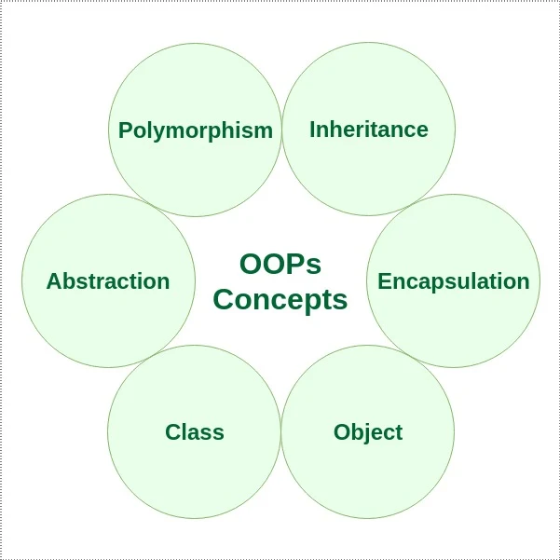
Introduction to OOPS

Slide 61
In general, Object-Oriented Programming (OOP) consists of classes and objects and aims to implement real-world entities like polymorphism, inheritance.
The class can be thought of as a representation or a design for objects. Classes will usually have their own methods (behavior) and attributes.
Attributes are individual entities that differentiate each object from the other and determine various qualities of an object. Methods, on the other hand, are more like how a function usually operates in programming. They determine how the instance of the class works. It's mostly because of methods (behavior); objects have the power to be done something to them.

Slide 62
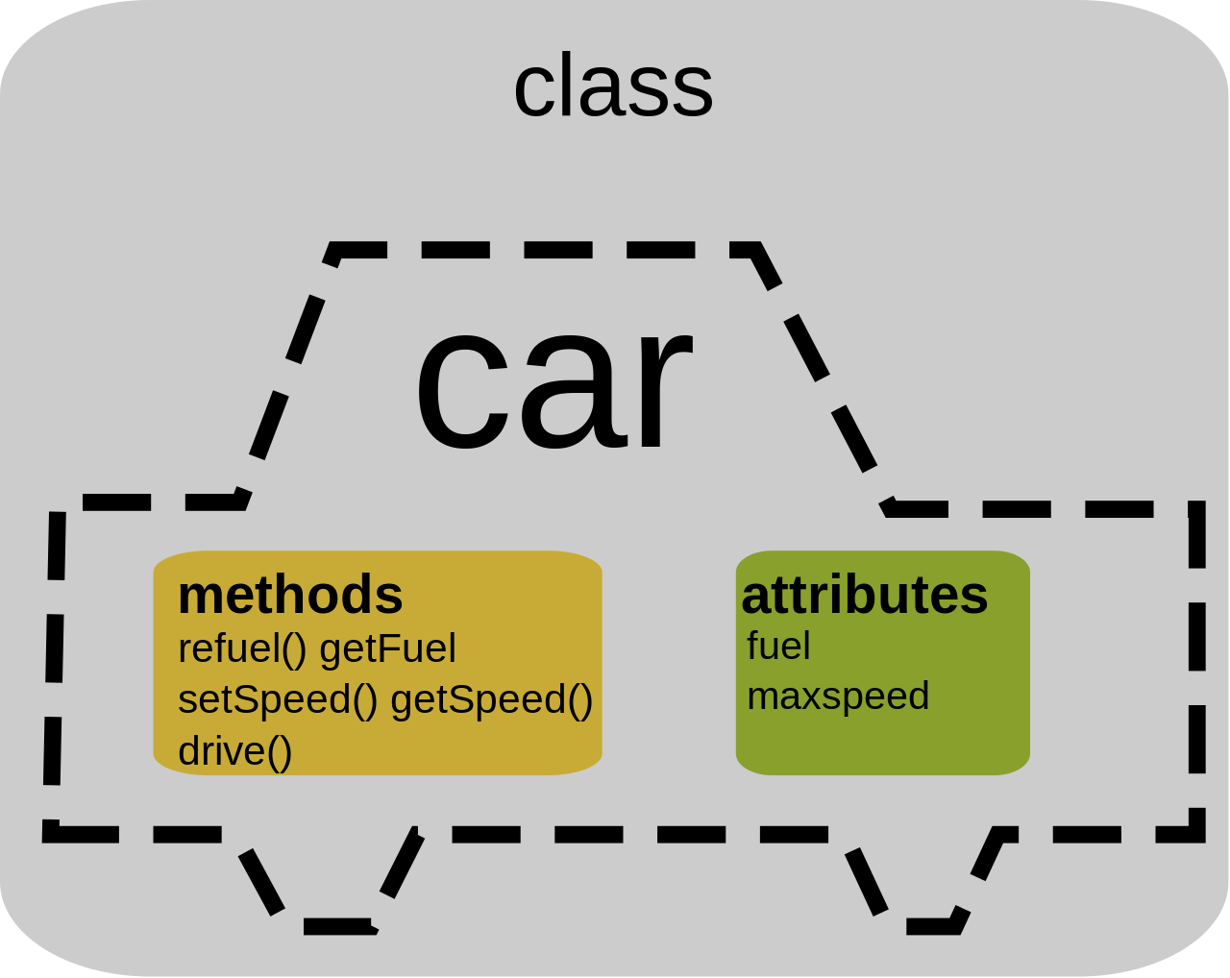
The above figure gives you more intuition about the flow of object-oriented programming or, to be more specific, what a class looks like. In the above picture, there is a class car which has attributes: fuel, max speed, and can have more attributes like the model, make, etc. It has different sets of methods like refuel(), getFuel(), setSpeed(), and some additional methods can be change gear, start the engine, stop the engine, etc.

Slide 63
Classes and Objects in Scala
Much like c++ and java, object-oriented programming in Scala follows pretty much the same conventions. It has the concept of defining classes and objects and within class constructors, and that is all there is to object-oriented programming in Scala.
Class Declaration
class Class_name{
// methods and attributes
}
Class in Scala is defined by the keyword class followed by the name of the class, and generally, the class name starts with a capital letter. There are few keywords which are optional but can be used in Scala class declaration like: class-name, it should begin with a capital letter: superclass, the parent class name preceded by extend keyword: traits, it is a comma-separated list implemented by the class preceded by extend keyword.
A class can in Scala inherits only one parent class, which means Scala does not support multiple inheritances. However, it can be achieved with the use of Traits.
Finally, the body of a class in Scala is surrounded by curly braces {}

Slide 64
class Car {
// Class variables
var make: String = "BMW"
var model: String = "X7"
var fuel: Int = 40
// Class method
def Display()
{
println("Make of the Car : " + make);
println("Model of the Car : " + model);
println("Fuel capacity of the Car : " + fuel);
}
}
object Main_Car_calss
{
// Main method
def main(args: Array[String])
{
// Class object
var obj = new Car();
obj.Display();
}
}

Slide 65
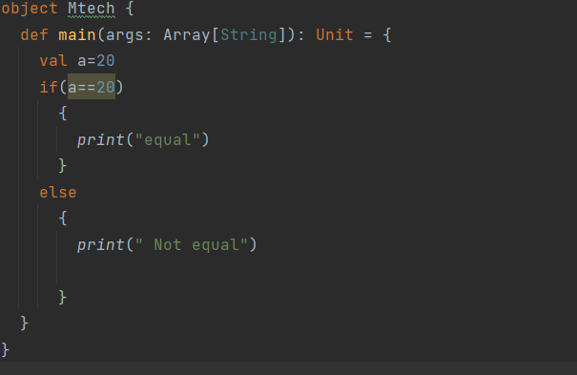
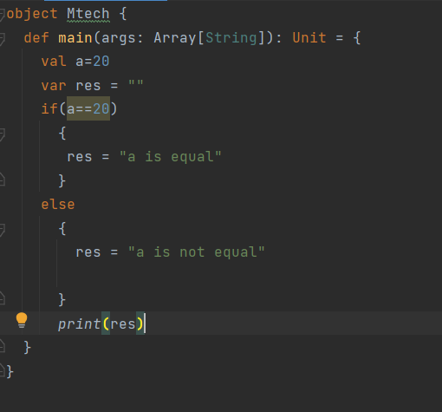
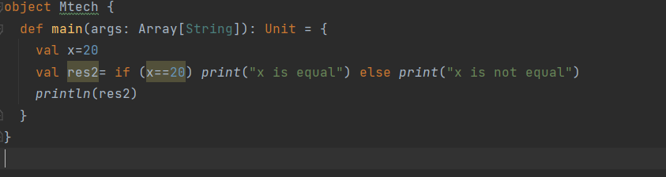
If Else Statement

Slide 69
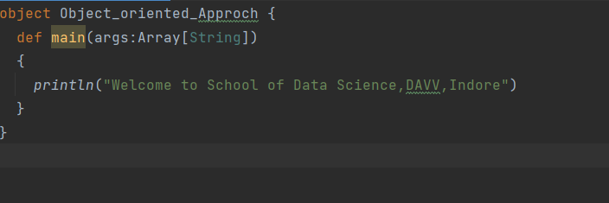
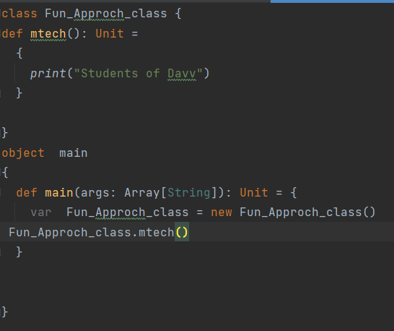
Object Oriented Approach
Funtional Approach
Object Oriented Approach

Slide 70
Case Class
Scala case classes are like regular classes except for the fact that they are good for modeling immutable data and serve as useful in pattern matching. Case classes include public and immutable parameters by default. These classes support pattern matching, which makes it easier to write logical code. The following are some of the characteristics of a Scala case class:
Instances of the class can be created without the new keyword.
As part of the case classes, Scala automatically generates methods such as equals(), hashcode(), and toString().
Scala generates accessor methods for all constructor arguments for a case class.
case class Case_Class(name:String, age:Int) object MainObject { def main(args:Array[String]) { var c = Case_Class("Xyz", 23) println("Student name:" + c.name); println("Student age: " + c.age); } }

Slide 71
Closure in Scala
class Clousre_feature { var x = 20 def function_name(y:Int) { println(x+y) } } object main { def main(args: Array[String]): Unit = { var obj = new Clousre_feature() obj.function_name(3) } }
Scala closures are functions whose return value is dependent on one or more free variables declared outside the closure function. Neither of these free variables is defined in the function nor is it used as a parameter, nor is it bound to a function with valid values. Based on the values of the most recent free variables, the closing function is evaluated.

Slide 72
Traits in Scala
The concept of traits is similar to an interface in Java, but they are even more powerful since they let you implement members. It is composed of both abstract and non-abstract methods, and it features a wide range of fields as its members. Traits can either contain all abstract methods or a mixture of abstract and non-abstract methods. In computing, a trait is defined as a unit that encapsulates the method and its variables or fields. Furthermore, Scala allows partial implementation of traits, but no constructor parameters may be included in traits. To create traits, use the trait keyword.

Slide 73
trait MyCompany
{
def company
def position
}
class MyClass extends MyCompany
{
def company()
{
println("Company: InterviewBit")
}
def position()
{
println("Position: SoftwareDeveloper")
}
def employee() //Implementation of class method
{
println("Employee: Aarav")
}
}
object Main
{
def main(args: Array[String])
{
val obj = new MyClass(); obj.company();
obj.position();
Obj.employee(); }
}

Slide 74
Nil, Null, None and Nothing
Null, null, Nil, Nothing, None, and Unit are all used to represent empty values in Scala.
Null refers to the absence of data, and its type is Null with a capital N.
Null is considered to be a list that contains zero items. Essentially, it indicates the end of the list.
Nothing is also a trait without instances.
None represents a sensible return value.
Unit is the return type for functions that return no value.

Slide 75
Inheritance in Scala
Inheritance is an important pillar of OOP(Object Oriented Programming). It is the mechanism in Scala by which one class is allowed to inherit the features(fields and methods) of another class.
Important terminology:
Super Class: The class whose features are inherited is known as superclass(or a base class or a parent class).
Sub Class: The class that inherits the other class is known as subclass(or a derived class, extended class, or child class). The subclass can add its own fields and methods in addition to the superclass fields and methods.
Reusability: Inheritance supports the concept of “reusability”, i.e. when we want to create a new class and there is already a class that includes some of the code that we want, we can derive our new class from the existing class. By doing this, we are reusing the fields and methods of the existing class.

Slide 76
How to use inheritance in Scala
The keyword used for inheritance is extends.
Syntax:
class child_class_name extends parent_class_name {
// Methods and fields
}
class Data_Science {
var Name: String = "Mtech"
}
class mtech extends Data_Science
{
var Roll_No: Int = 130
// Method// Method
def details()
{
println("Stream name: " +Name);
println("Roll number of student: " +Roll_No);
}
}
object Main_Inheritance
{
// Driver code
def main(args: Array[String])
{
// Creating object of derived class
val ob = new mtech();
ob.details();
}
}

Slide 77
Type of inheritance
Below are the different types of inheritance which are supported by Scala.
Single Inheritance: In single inheritance, derived class inherits the features of one base class. In the image below, class Data Science serves as a base class for the derived class metch.
class Data_Science {
var Name: String = "Mtech"
}
class mtech extends Data_Science
{
var Roll_No: Int = 130
// Method// Method
def details()
{
println("Stream name: " +Name);
println("Roll number of student: " +Roll_No);
}
}
object Main_Inheritance
{
// Driver code
def main(args: Array[String])
{
// Creating object of derived class
val ob = new mtech();
ob.details();
}
}
Data Science
(Base Class)
metch
(Derive Class)

Slide 78
In Multilevel Inheritance, a derived class will be inheriting a base class and as well as the derived class also act as the base class to another class. In the below image, the class Data Science serves as a base class for the derived class metch1
, which in turn serves as a base class for the derived class Info.
Multilevel Inheritance:
Data Science
(Base Class)
class Multilevel {
var Name: String = "Mtech"
}
class mtech1 extends Multilevel {
var Roll_No: Int = 130
}
class info extends mtech1
{
// Method
def details()
{
println("Name: " +Name);
println("Roll_number: " +Roll_No);
}
}
object Multilevel_Inheritance
{
def main(args: Array[String]): Unit = {
val ob = new info();
ob.details();
}
}
metch1
(Derive Class)
Info

Slide 79
Hierarchical Inheritance: In Hierarchical Inheritance, one class serves as a superclass (base class) for more than one subclass.In below image, class Hierarchical
serves as a base class for the derived class child1 , child2.
class Hierarchical {
var Name1: String = "Siya"
var Name2: String = "Soniya"
}
class Child1 extends Hierarchical
{
var Age: Int = 32
def details1()
{
println(" Name: " +Name1);
println(" Age: " +Age);
}
}
// Derived from Parent class
class Child2 extends Hierarchical
{
var Height: Int = 164
// Method
def details2()
{
println(" Name: " +Name2);
println(" Height: " +Height);
}
}
object Main_Hierarchical
{
// Driver code
def main(args: Array[String])
{
// Creating objects of both derived classes
val ob1 = new Child1();
val ob2 = new Child2();
ob1.details1();
ob2.details2();
}
}
Hierarchical
child1
Child2

Slide 80
class Scala_Traits {
var Name: String = "Mtech"
}
class Roll_num {
var Roll_No: Int = 130
}
class info_mtech_stu extends Scala_Traits with Roll_num {
def display()
{
println("Name: " +Name);
println("Roll_number: " +Roll_No);
}
}
object traits_scala
{
def main(args: Array[String]): Unit = {
val ob = new info_mtech_stu();
ob.display();
}
}

Slide 81
Multiple Inheritance: In Multiple inheritance ,one class can have more than one superclass and inherit features from all parent classes. Scala does not support multiple inheritance with classes, but it can be achieved by traits.
trait Scala_Traits {
var Name: String = "Mtech"
}
trait Roll_num {
var Roll_No: Int = 130
}
class info_mtech_stu extends Scala_Traits with Roll_num{
def display()
{
println("Name: " +Name);
println("Roll_number: " +Roll_No);
}
}
object traits_scala
{
def main(args: Array[String]): Unit = {
val ob = new info_mtech_stu();
ob.display();
}
}
Scala_traits
Roll_num
Info_mtech_stu

Slide 82
Hybrid Inheritance: It is a mix of two or more of the above types of inheritance. Since Scala doesn’t support multiple inheritance with classes, the hybrid inheritance is also not possible with classes. In Scala, we can achieve hybrid inheritance only through traits.
A
B
C
D

Slide 83
class A { var numA: Int = 0;
def setA(n: Int) { numA = n;
}
def printA() { printf("numA: %d\n", numA);
}
}
class B extends A {var numB: Int = 0;
def setB(n: Int) { numB = n;
}
def printB() { printf("numB: %d\n", numB);
}
}
class C extends B { var numC: Int = 0;
def setC(n: Int) { numC = n;
}
def printC() { printf("numC: %d\n", numC);
}
}
class D extends A { var numD: Int = 0;
def setD(n: Int) { numD = n;
}
def printD() { printf("numD: %d\n", numD);
}
}
object hybrid_inheritance
{
def main(args: Array[String]): Unit = {
var obj1 = new C();
var obj2 = new D();
obj1.setA(10); obj1.setB(20); obj1.setC(30); obj1.printA(); obj1.printB();
obj1.printC(); obj2.setA(40); obj2.setD(50);
obj2.printA(); obj2.printD();
}
}

Slide 84
Traits | Abstract Class
Traits support multiple inheritance. | Abstract class does not support multiple inheritance.
We are allowed to add a trait to an object instance. | We are not allowed to add an abstract class to an object instance.
Traits does not contain constructor parameters. | Abstract class contain constructor parameters.
Traits are completely interoperable only when they do not contain any implementation code. | Abstract class are completely interoperable with Java code.

Slide 85
Scala Polymorphism
Polymorphism is the ability of any data to be processed in more than one form. The word itself indicates the meaning as poly means many and morphism means types. Scala implements polymorphism through virtual functions, overloaded functions and overloaded operators.
Polymorphism is one of the most important concept of object oriented programming language. The most common use of polymorphism in object oriented programming occurs when a parent class reference is used to refer to a child class object. Here we will see how represent any function in many types and many forms. Real life example of polymorphism, a person at the same time can have different roles to play in life. Like a woman at the same time is a mother, a wife, an employee and a daughter. So the same person has to have many features but has to implement each as per the situation and the condition. Polymorphism is considered as one of the important features of Object Oriented Programming. In Scala the function can be applied to arguments of many types, or the type can have instances of many types.

Slide 86
Two to Achieve Polymorphism
Scala Method Overloading
Scala provides method overloading feature which allows us to define methods of same name but having different parameters or data types. It helps to optimize code.
Scala Method Overloading Example by using Different Parameters
In the following example, we have define two add methods with different number of parameters but having same data type.
class Arithmetic{
def add(a:Int, b:Int){
var sum = a+b
println(sum)
}
def add(a:Int, b:Int, c:Int){
var sum = a+b+c
println(sum)
}
}
object MainObject{
def main(args:Array[String]){
var a = new Arithmetic();
a.add(10,10);
a.add(10,10,10);
}
}

Slide 87
Method Overriding in Scala
Method Overriding in Scala is identical to the method overriding in Java but in Scala, the overriding features are further elaborated as here, both methods as well as var or val can be overridden. If a subclass has the method name identical to the method name defined in the parent class then it is known to be Method Overriding i.e, the sub-classes which are inherited by the declared super class, overrides the method defined in the super class utilizing the override keyword.
class Scala_Overridding {
def NumberOfStudents()=
{ 0 // Utilized for returning an Integer
}
}
class class_1 extends Scala_Overridding {
// Using Override keyword
override def NumberOfStudents() = {
30
}
}
class class_2 extends Scala_Overridding
{
// Using override keyword
override def NumberOfStudents()=
{
32 }
}class class_3 extends Scala_Overridding
{ // Using override keyword
override def NumberOfStudents()=
{ 29 }
}
object Scala_Overridding_Obj{
def main(args: Array[String]): Unit = {
var x=new class_1()
var y=new class_2()
var z=new class_3()
// Displays number of students in class_1
println("Number of students in class 1 : " +
x.NumberOfStudents())
// Displays number of students in class_2
println("Number of students in class 2 : " +
y.NumberOfStudents())
// Displays number of students in class_3
println("Number of students in class 3 : " +
z.NumberOfStudents())
}
}
In the above example, we have a class named Scala_Overridding which defines a method NumberOfStudents() and we have three classes i.e, class_1, class_2 and class_3 which inherit from the super-class School and these sub-classes overrides the method defined in the super-class.

Slide 88
Overriding vs Overloading
In Scala, method overloading supplies us with a property which permits us to define methods of identical name but they have different parameters or data types whereas, method overriding permits us to redefine method body of the super class in the subclass of same name and same parameters or data types in order to alter the performance of the method.
In Scala, method overriding uses override modifier in order to override a method defined in the super class whereas, method overloading does not requires any keyword or modifier, we just need to change, the order of the parameters used or the number of the parameters of the method or the data types of the parameters for method overloading.

Slide 89
Lambda Expression in Scala
Lambda Expression refers to an expression that uses an anonymous function instead of variable or value. Lambda expressions are more convenient when we have a simple function to be used in one place. These expressions are faster and more expressive than defining a whole function. We can make our lambda expressions reusable for any kind of transformations. It can iterate over a collection of objects and perform some kind of transformation to them.
Syntax:
val lambda_exp = (variable:Type) => Transformation_Expression
Example:
// lambda expression to find double of x
val ex = (x:Int) => x + x

Slide 90
Working With Lambda Expressions
We can pass values to a lambda just like a normal function call.
Example :
object Scala_lambda {
def main(args: Array[String]): Unit = {
// lambda expression
val ex1 = (x:Int) => x + 2
// with multiple parameters
val ex2 = (x:Int, y:Int) => x * y
println(ex1(7))
println(ex2(2, 3))
}
}
We can see that the defined anonymous function to perform the square operation is not reusable.
We are passing it as an argument. However, we can make it reusable and may use it with different collections.

Slide 91
object Scala_Lambda_reuse {
def main(args: Array[String]): Unit = {
val l1 = List(1, 1, 2, 3, 5, 8)
val l2 = List(13, 21, 34)
// reusable lambda
val func = (x:Int) => x * x
// squaring each element of the lists
val res1 = l1.map( func )
val res2 = l2.map( func )
println(res1)
println(res2)
}
}

Slide 92
A lambda can also be used as a parameter to a function.
object Scala_lambda_AsParameter {
// transform function with integer x and
// function f as parameter
// f accepts Int and returns Double
def transform( x:Int, f:Int => Double)
=
f(x)
def main(args: Array[String]): Unit = {
// lambda is passed to f:Int => Double
val res = transform(2, r => 3.14 * r * r)
println(res)
}
}
In above example, transform function accepts integer x and function f, applies the transformation to x defined by f. Lambda passed as the parameter in function call returns Double type. Therefore, parameter f must obey the lambda definition.

Slide 93
We can perform the same task on any collection as well. In case of collections, the only change we need to make in transform function is using map function to apply transformation defined by f to every element of the list l.
object Scala_lambda_WithAnyCollection {
def transform( l:List[Int], f:Int => Double)
= {
l.map(f)
}
def main(args: Array[String]): Unit = {
// lambda is passed to f:Int => Double
val res = transform(List(1, 2, 3), r => 3.14 * r * r)
println(res)
}
}

Slide 94
Anonymous Functions in Scala
In Scala, An anonymous function is also known as a function literal. A function which does not contain a name is known as an anonymous function. An anonymous function provides a lightweight function definition. It is useful when we want to create an inline function.
Syntax:
(z:Int, y:Int)=> z*y
Or
(_:Int)*(_Int)
In the above first syntax, => is known as a transformer. The transformer is used to transform the parameter-list of the left-hand side of the symbol into a new result using the expression present on the right-hand side.
In the above second syntax, _ character is known as a wildcard is a shorthand way to represent a parameter who appears only once in the anonymous function.

Slide 95
Anonymous Functions With Parameters
When a function literal is instantiated in an object is known as a function value. Or in other words, when an anonymous function is assigned to a variable then we can invoke that variable like a function call. We can define multiple arguments in the anonymous function.
object Scala_Anonymous_Fun {
def main(args: Array[String]): Unit = {
// Creating anonymous functions
// with multiple parameters Assign
// anonymous functions to variables
// var myfc1 = (str1:String, str2:String) => str1 + str2
var myfc1 = (str1:Int, str2:Int) => str1 + str2
// An anonymous function is created
// using _ wildcard instead of
// variable name because str1 and
// str2 variable appear only once
var myfc2 = (_:String) + (_:String)
// Here, the variable invoke like a function call
println(myfc1(1, 2))
println(myfc2("MBA", "BBA"))
}
}

Slide 96
Anonymous Functions Without Parameters
We are allowed to define an anonymous function without parameters.
object Scala_AnonymousFun_Without_Parameters {
def main(args: Array[String]): Unit = {
var myfun1 = () => {"Welcome to School of Data Science!!"}
println(myfun1())
}
}

Slide 97
Scala Closures
Scala Closures are functions which uses one or more free variables and the return value of this function is dependent of these variable. The free variables are defined outside of the Closure Function and is not included as a parameter of this function. So the difference between a closure function and a normal function is the free variable. A free variable is any kind of variable which is not defined within the function and not passed as the parameter of the function. A free variable is not bound to a function with a valid value. The function does not contain any values for the free variable.
class Clousre_feature
{
var x = 20
def function_name(y:Int)
{
var x=12;
println(x+y)
}
}
object main
{
def main(args: Array[String]): Unit = {
var obj = new Clousre_feature()
obj.function_name(3)
}
}

Slide 98
Scala Final
Final is a keyword, which is used to prevent inheritance of super class members into derived class. You can declare final variables, methods and classes also.
Scala Final Variable Example
You can't override final variables in subclass. Let's see an example.
class Scala_Vechile {
final val speed:Int = 60
}
class Bike extends Scala_Vechile{
override val speed:Int = 100
def show(){
println(speed)
}
}
object MainObject{
def main(args:Array[String]){
var b = new Bike()
b.show()
}
}
cannot override final member:
final val speed: Int (defined in class Scala_Vechile)
override val speed:Int = 100

Slide 99
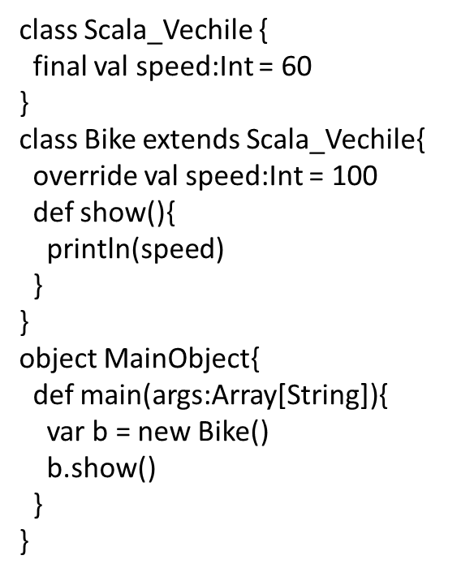
Scala Final class
Scala Final Member
Scala Final Method
final class Vehicle{
def show(){
println("vehicle is running")
}
}
class Bike extends Vehicle{
override def show(){
println("bike is running")
}
}
object MainObject{
def main(args:Array[String]){
var b = new Bike()
b.show()
}
}
class Scala_Vehicle{
final def show(){
println("vehicle is running")
}
}
class Bike extends Scala_Vehicle{
//override val speed:Int = 100
override def show(){
println("bike is running")
}
}
object MainObject{
def main(args:Array[String]){
var b = new Bike()
b.show()
}
}
Cannot override final member,Final Methods, Final Class

Slide 100
Scala this
In scala, this is a keyword and used to refer current object. we can call instance variables, methods, constructors by using this keyword.
class Scala_This {
var id:Int = 0
var name: String = ""
def this(id:Int, name:String){
this()
this.id = id
this.name = name
}
def show(){
println(id+" "+name)
}
}
object this_main
{
def main(args: Array[String]): Unit = {
var t = new Scala_This(101,"Martin")
t.show()
}
}

Slide 101
Scala Constructor Calling by using this keyword
In the following example this is used to call constructor. It illustrates how we can call constructor from other constructor. we must make sure that this must be first statement in the constructor while calling to other constructor otherwise compiler throws an error.

Slide 103
Scala | yield Keyword
yield keyword will returns a result after completing of loop iterations. The for loop used buffer internally to store iterated result and when finishing all iterations it yields the ultimate result from that buffer. It doesn’t work like imperative loop. The type of the collection that is returned is the same type that we tend to were iterating over, Therefore a Map yields a Map, a List yields a List, and so on.
object Scala_Yield {
def main(args: Array[String]): Unit = {
// Using yield with for
var print = for( i <- 1 to 10) yield i
for(j<-print)
{
// Printing result
println(j)
}
}
}

Slide 104
Scala Singleton and Companion Objects
Singleton Object
Scala is more object oriented language than Java so, Scala does not contain any concept of static keyword. Instead of static keyword Scala has singleton object. A Singleton object is an object which defines a single object of a class. A singleton object provides an entry point to our program execution. If we do not create a singleton object in our program, then our code compile successfully but does not give output. So we required a singleton object to get the output of our program. A singleton object is created by using object keyword.
Syntax:
object Name{
// code...
}
Important points about singleton object
The method in the singleton object is globally accessible.
You are not allowed to create an instance of singleton object.
You are not allowed to pass parameter in the primary constructor of singleton object.
In Scala, a singleton object can extend class and traits.
In Scala, a main method is always present in singleton object.
The method in the singleton object is accessed with the name of the object(just like calling static method in Java), so there is no need to create an object to access this method.

Slide 105
object Scala_Singleton {
def hello():Int={
var x=10
return x
}
def main(args: Array[String]): Unit = {
var c=Scala_Singleton.hello()
print(c)
}
}
object Scala_Singleton {
def hello(){
print("hello Mtech students")
}
def main(args: Array[String]): Unit = {
Scala_Singleton.hello()
}
}

Slide 106
Scala Companion Object
In scala, when we have a class with same name as singleton object, it is called companion class and the singleton object is called companion object
The companion class and its companion object both must be defined in the same source file.
class Scala_ComapanionClass {
def hello(){
println("Hello, this is Companion Class.")
}
}
object CompanoinObject{
def main(args:Array[String]){
new Scala_ComapanionClass().hello()
println("And this is Companion Object.")
}
}

Slide 107
Scala Case Classes and Case Object
Scala case classes are just regular classes which are immutable by default and decomposable through pattern matching.It uses equal method to compare instance structurally. It does not use new keyword to instantiate object.All the parameters listed in the case class are public and immutable by default.
case class Scala_Case_Class(name:String, age:Int)
case class Scala_Case_Class1(name:String, age:Int,roll:Int)
object Scala_Case_CLass_Obj
{
def main(args: Array[String]): Unit = {
// var c = Scala_Case_Class("Nidhi", 23)
var d = Scala_Case_Class1("Nidhi", 23, 34)
// Display both Parameter
println("Name of the employee is " + d.name);
println("Age of the employee is " + d.roll);
}
}
Syntax
case class className(parameters)

Slide 108
Constructors are used to initializing the object’s state. Like methods, a constructor also contains a collection of statements(i.e. instructions) that are executed at the time of Object creation.
Scala supports two types of constructors:
Primary Constructor
When our Scala program contains only one constructor, then that constructor is known as a primary constructor. The primary constructor and the class share the same body, means we need not to create a constructor explicitly.
class Scala_Primary_Constructor(id:Int, name:String)
{
def showDetails(){
println(id+" "+name);
}
}
object Scala_Primary_Constructor{
def main(args: Array[String]): Unit = {
var s = new Scala_Primary_Constructor(101,"Rama");
s.showDetails()
}
}
Syntax:
class class_name(Parameter_list){
// Statements...
}
Important points:
In the above syntax, the primary constructor and the class share the same body so, anything defined in the body of the class except method declaration is the part of the primary constructor.
Example:

Slide 109
The primary constructor may contain zero or more parameters.
If we do not create a constructor in our Scala program, then the compiler will automatically create a primary constructor when we create an object of our class, this constructor is known as a default primary constructor. It does not contain any parameters.
Example:
class Scala_Default_Primary_Constructor {
def show() {
println("Hello from default constructor");
}
}
object Scala_default{
def main(args: Array[String]): Unit = {
var obj= new Scala_Default_Primary_Constructor()
obj.show()
}
}

Slide 110
Auxiliary Constructor
In a Scala program, the constructors other than the primary constructor are known as auxiliary constructors. we are allowed to create any number of auxiliary constructors in our program, but a program contains only one primary constructor.
Syntax:
def this(......)
Important points:
In a single program, we are allowed to create multiple auxiliary constructors, but they have different signatures or parameter-lists.
Every auxiliary constructor must call one of the previously defined constructors.
The invoke constructor may be a primary or another auxiliary constructor that comes textually before the calling constructor.
The first statement of the auxiliary constructor must contain the constructor call using this.

Slide 111
class Scala_Primary_Constructor(id:Int, name:String)
{
def showDetails(){
println(id+" "+name);
}
}
object Scala_Primary_Constructor{
def main(args: Array[String]): Unit = {
var s = new Scala_Primary_Constructor(101,"Rama");
s.showDetails()
}
}
class Scala_Auxiliary_Constructor(Aname: String, Cname: String) {
var no: Int = 0;;
def display()
{
println("Author name: " + Aname);
println("Chapter name: " + Cname);
println("Total number of articles: " + no);
}
// Auxiliary Constructor
def this(Aname: String, Cname: String, no:Int)
{
// Invoking primary constructor
this(Aname, Cname)
this.no=no
}
}
object Main_Auxiliary_Constructor
{
def main(args: Array[String])
{
// Creating object of GFG class
var obj = new Scala_Auxiliary_Constructor("Anya", "Constructor", 34);
obj.display();
}
}

Slide 112
In Scala, we are allowed to make a primary constructor private by using a private keyword in between the class name and the constructor parameter-list.
Syntax:
// private constructor with two argument
class constructor private(name: String, class:Int){
// code..
}
// private constructor without argument
class constructor private{
// code...
}
In Scala, we are allowed to give default values in the constructor declaration.
Example:

Slide 116
Scala Trait Mixins
In scala, trait mixins means we can extend any number of traits with a class or abstract class. we can extend only traits or combination of traits and class or traits and abstract class.
It is necessary to maintain order of mixins otherwise compiler throws an error.
we can use mixins in scala like this:
Scala Trait Example: Mixins Order Not Maintained
In this example, we have extended a trait and an abstract class. Let's see what happen.

Slide 117
trait Print {
def print()
}
abstract class PrintA4{
def printA4()
}
class A6 extends Print with PrintA4{
def print(){ // Trait print
println("print sheet")
}
def printA4(){ // Abstract class printA4
println("Print A4 Sheet")
}
}
object MainObject_trait {
def main(args: Array[String]) {
var a = new A6()
a.print()
a.printA4()
}
}
class PrintA4 needs to be a trait to be mixed in
class A6 extends Print with PrintA4{
trait Scala_Mixims_Traits {
def print()
}
abstract class PrintA4{
def printA4()
}
class A6 extends PrintA4 with Scala_Mixims_Traits{ // First one is abstract class second one is trait
def print(){ // Trait print
println("print sheet")
}
def printA4(){ // Abstract class printA4
println("Print A4 Sheet")
}
}
object MainObject_Maxims_Traits{
def main(args:Array[String]){
var a = new A6()
a.print()
a.printA4()
}
}
Scala Mixins Order
The right mixins order of trait is that any class or abstract class which you want to extend, first extend this. All the traits will be extended after this class or abstract class.
Scala Trait Example: Mixins Order Maintained

Slide 118
Currying Functions in Scala with Examples
Currying in Scala is simply a technique or a process of transforming a function. This function takes multiple arguments into a function that takes single argument. It is applied widely in multiple functional languages.
Syntax
def function name(argument1, argument2) = operation
Let’s understand with a simple example,
Example:
object Scala_Currying {
// Define currying function
def add(x: Int, y: Int) = x + y;
def main(args: Array[String]): Unit = {
println(add(20, 19));
}
}
Here, we have define add function which takes two arguments (x and y) and the function simply adds x and y and gives us the result, calling it in the main function.

Slide 119
Another way to declare currying function
Suppose, we have to transform this add function into a Curried function, that is transforming the function that takes two(multiple) arguments into a function that takes one(single) argument.
Syntax
def function name(argument1) = (argument2) => operation
Example
object Scala_Currying_Another_Way {
// transforming the function that
// takes two(multiple) arguments into
// a function that takes one(single) argument.
def add2(a: Int) = (b: Int) => a + b;
def main(args: Array[String]): Unit = {
println(add2(20)(19));
}
}

Slide 120
Here, we have define add2 function which takes only one argument a and we are going to return a second function which will have the value of add2. The second function will also take an argument let say b and this function when called in main, takes two parenthesis(add2()()), where the first parenthesis is of the function add2 and second parenthesis is of the second function. It will return the addition of two numbers, that is a+b. Therefore, we have curried the add function, which means we have transformed the function that takes two arguments into a function that takes one argument and the function itself returns the result.

Slide 121
Currying Function Using Partial Application
We have another way to use this Curried function and that is Partially Applied function. So, let’s take a simple example and understand. we have defined a variable sum in the main function
Example
object Scala_Currying_Partial_Application {
def add2(a: Int) = (b: Int) => a + b;
def main(args: Array[String]): Unit = {
// Partially Applied function.
val sum = add2(29);
println(sum(5));
}
}

Slide 123
Scala File handling
Scala provides predefined methods to deal with file. we can create, open, write and read file. Scala provides a complete package scala.io for file handling.
Scala Creating a File Example
Scala doesn't provide file writing methods. So, we will use the Java PrintWriter or FileWriter methods.
Creating a new file :
java.io.File defines classes and interfaces for the JVM access files, file systems and attributes.
File(String pathname) converts theparameter string to abstract path name, creating a new file instance.
Writing to the file
java.io.PrintWriter includes all the printing methods included in PrintStream.

Slide 124
// File handling program
import java.io.File
import java.io.PrintWriter
object Scala_File_Handling {
// Main method
def main(args:Array[String])
{
// Creating a file
val file_Object = new File("C:\\Users\\Makhan\\IdeaProjects\\abc.txt1" )
// Passing reference of file to the printwriter
val print_Writer = new PrintWriter(file_Object)
// Writing to the file
print_Writer.write("Hello, This is Mtech Sudents")
// Closing printwriter
print_Writer.close()
}
}
A text file abc.txt is created and contains the string “Hello, This is Mtech Students”
Scala does not provide class to write a file but it provide a class to read the files. This is the class Source. We use its companion object to read files. To read the contents of this file, we call the fromFile() method of class Source for reading the contents of the file which includes filename as argument.

Slide 125
A text file abc.txt is created and contains the string “Hello, This is Mtech Students”
Scala does not provide class to write a file but it provide a class to read the files. This is the class Source. We use its companion object to read files. To read the contents of this file, we call the fromFile() method of class Source for reading the contents of the file which includes filename as argument.

Slide 126
Creating a file in Scala and writing content to it
import java.io._
object Scala_File_Writing_and_Reading {
def main(args: Array[String]): Unit = {
val file = new File("C:\\Users\\Makhan\\IdeaProjects\\Mtech.txt" )
//creating object of the PrintWrite
//by passing the reference to the file
val pw = new PrintWriter(file)
//writing text to the file
pw.write("Welcome to School of Data science")
pw.write("writing text to the file\n")
//closing the PrintWriter
pw.close()
println("PrintWriter saved and closed...")
}
}

Slide 127
Reading Content line by line in Scala
import scala.io.Source
object Scala_File_Reading_line_by_line {
def main(args: Array[String]): Unit = {
val filename = "C:\\Users\\Makhan\\IdeaProjects\\Mtech.txt"
//file reading - creating object name by passing
//filename i.e. file object
val filereader = Source.fromFile(filename)
//printing characters
for(line <-filereader.getLines())
{
println(line)
}
//closing
filereader.close()
}
}

Slide 128
Scala Reading File Example: Reading Each Charactar
import scala.io.Source
object Scala_File_handling_Reading_Each_Char {
def main(args: Array[String]): Unit = {
val filename = "C:\\Users\\Makhan\\IdeaProjects\\Mtech2.txt"
val fileSource = Source.fromFile(filename)
while(fileSource.hasNext){
println(fileSource.next)
}
fileSource.close()
}
}

Slide 129
Scala Multithreading
Multithreading is a process of executing multiple threads simultaneously. It allows we to perform multiple operations independently.
we can achieved multitasking by using Multithreading. Threads are lightweight sub-processes which occupy less memory. Multithreading are used to develop concurrent applications in Scala.
Scala does not provide any separate library for creating thread. If we are familiar with multithreading concept of Java, we will come to know that it is similar except the syntax of Scala language itself.
we can create thread either by extending Thread class or Runnable interface. Both provide a run method to provide specific implementation.

Slide 130
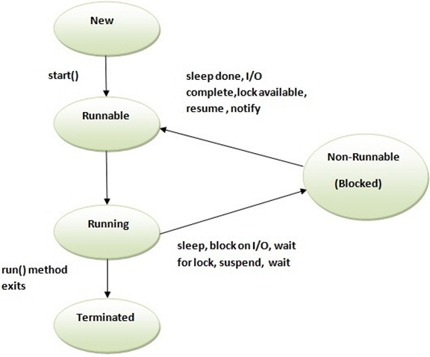
Scala Thread Life Cycle
Thread life cycle is a span of time in which thread starts and terminates. It has various phases like new, runnable, terminate, block etc. Thread class provides various methods to monitor thread's states.
The Scala thread states are as follows:
New
Runnable
Running
Non-Runnable (Blocked)
Terminated

Slide 131
1) New
This is the first state of thread. It is just before starting of new thread.
2) Runnable
This is the state when thread has been started but the thread scheduler has not selected it to be the running thread.
3) Running
The thread is in running state if the thread scheduler has selected it.
4) Non-Runnable (Blocked)
This is the state when the thread is still alive, but is currently not eligible to run due to waiting for input or resources.
5) Terminated
A thread is in terminated or dead state when its run() method exits.

Slide 132
Scala Thread
There are two ways to create a thread:
By extending Thread class
By implementing Runnable interface
By extending Thread class
class Scala_Thread_Using_Extending_Thread extends Thread {
override def run() {
println("Thread is running...");
}
}
object MainObject_thread{
def main(args:Array[String]){
var t = new Scala_Thread_Using_Extending_Thread()
t.start()
}
}

Slide 133
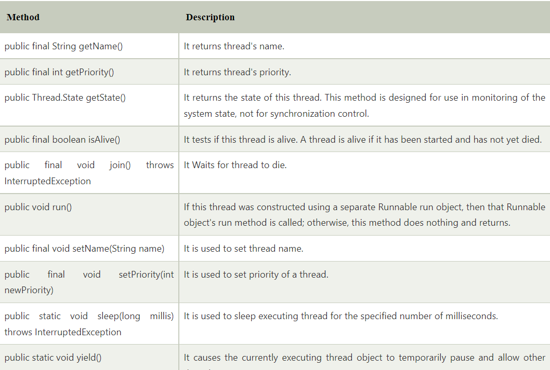
Scala Thread Methods
Thread class provides various methods to deals with thread's states.wecan use these methods to control the flow of thread.
The following table contains commonly used methods of Thread class.

Slide 134
Scala Thread sleep() Method
The sleep() method is used to sleep thread for the specified time. It takes time in milliseconds as an argument.
class Scala_Thread_Sleep extends Thread {
override def run(){
for(i<- 0 to 5){
println(i)
Thread.sleep(500)
}
}
}
object Scala_Thread_Sleep_obj{
def main(args: Array[String]): Unit = {
var t1 = new Scala_Thread_Sleep()
var t2 = new Scala_Thread_Sleep()
t1.start()
t2.start()
}
}

Slide 135
Scala Thread join() Method Example
The join() method waits for a thread to die. In other words, The join() method is used to hold the execution of currently running thread until the specified thread finished it's execution.
class Scala_Thread_join extends Thread {
override def run(){
for(i<- 0 to 5){
println(i)
Thread.sleep(500)
}
}
}
object Scala_Thread_join_obj{
def main(args: Array[String]): Unit = {
var t1 = new Scala_Thread_join()
var t2 = new Scala_Thread_join()
var t3 = new Scala_Thread_join()
t1.start()
t1.join()
t2.start()
t3.start()
}
}

Slide 136
Scala setName() Method Example
In the following example, we are setting and getting names of threads.
class Scala_Thread_setName_Method extends Thread{
override def run(){
for(i<- 0 to 5){
println(this.getName()+" - "+i)
Thread.sleep(500)
}
}
}
object Scala_Thread_setName_Method_obj{
def main(args: Array[String]): Unit = {
var t1 = new Scala_Thread_setName_Method()
var t2 = new Scala_Thread_setName_Method()
var t3 = new Scala_Thread_setName_Method()
t1.setName("First Thread")
t2.setName("Second Thread")
t1.start()
t2.start()
}
}

Slide 137
Scala Thread Priority Example
We can set thread priority by using it's predefined method. The following example sets priority for the thread.
class Scala_Thread_Priority extends Thread {
override def run() {
for (i <- 0 to 5) {
println(this.getName())
println(this.getPriority())
Thread.sleep(500)
}
}
}
object Scala_Thread_Priority_obj
{
def main(args: Array[String]): Unit = {
var t1 = new Scala_Thread_Priority()
var t2 = new Scala_Thread_Priority()
t1.setName("First Thread")
t2.setName("Second Thread")
t1.setPriority(Thread.MIN_PRIORITY)
t2.setPriority(Thread.MAX_PRIORITY)
t1.start()
t2.start()
}
}

Slide 138
class Scala_Thread_Multitasking extends Thread {
override def run() {
for (i <- 0 to 5) {
println(i)
Thread.sleep(500)
}
}
def task() {
for (i <- 0 to 5) {
println(i)
Thread.sleep(200)
}
}
}
object Scala_Thread_Multitasking_obj{
def main(args: Array[String]): Unit = {
var t1 = new Scala_Thread_Multitasking()
t1.start()
t1.task()
}
}

Slide 139
What is Git?
Git is a popular version control system. It was created by Linus Torvalds in 2005, and has been maintained by Junio Hamano since then.
It is used for:
Tracking code changes
Tracking who made changes
Coding collaboration
What does Git do?
Manage projects with Repositories
Clone a project to work on a local copy
Control and track changes with Staging and Committing
Branch and Merge to allow for work on different parts and versions of a project
Pull the latest version of the project to a local copy
Push local updates to the main project
Working with Git
Initialize Git on a folder, making it a Repository
Git now creates a hidden folder to keep track of changes in that folder
When a file is changed, added or deleted, it is considered modified
You select the modified files you want to Stage
The Staged files are Committed, which prompts Git to store a permanent snapshot of the files
Git allows you to see the full history of every commit.
You can revert back to any previous commit.
Git does not store a separate copy of every file in every commit, but keeps track of changes made in each commit!

Slide 140
What is GitHub?
Git is not the same as GitHub.
GitHub makes tools that use Git.
GitHub is the largest host of source code in the world, and has been owned by Microsoft since 2018.
Using Git with Command Line
To start using Git, we are first going to open up our Command shell.
For Windows, you can use Git bash, which comes included in Git for Windows. For Mac and Linux you can use the built-in terminal.
The first thing we need to do, is to check if Git is properly installed:

Slide 149
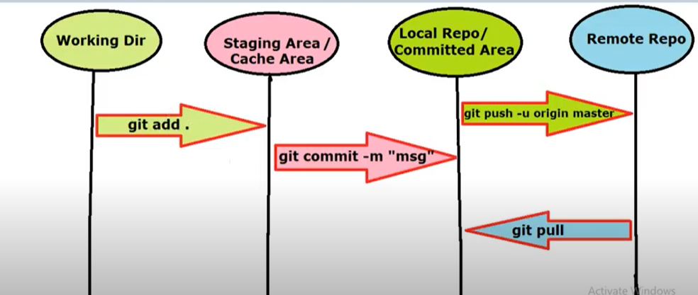

Slide 150
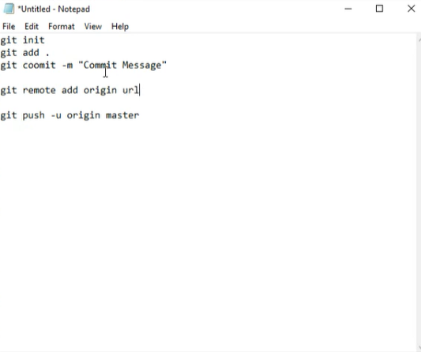

Slide 151
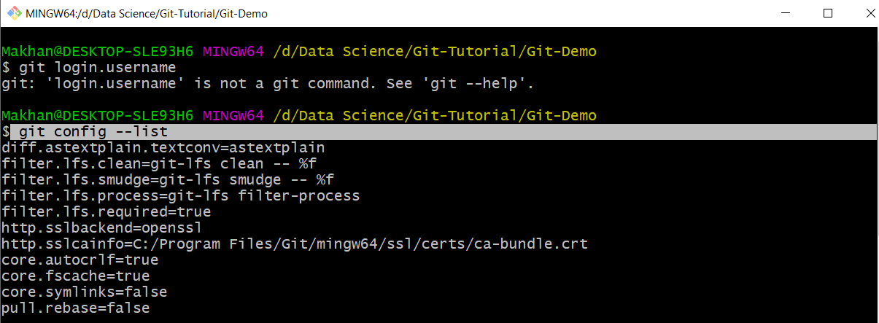
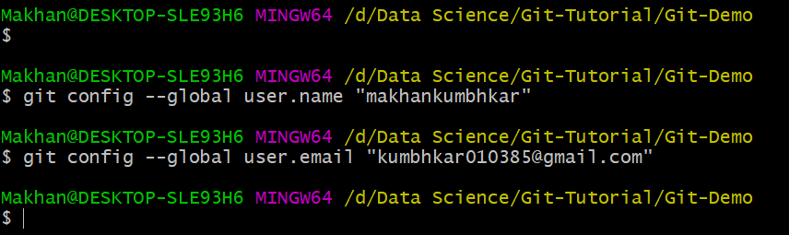

Slide 152
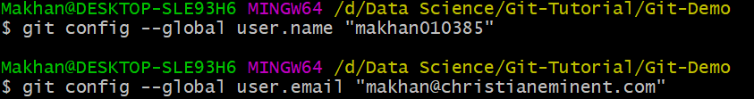
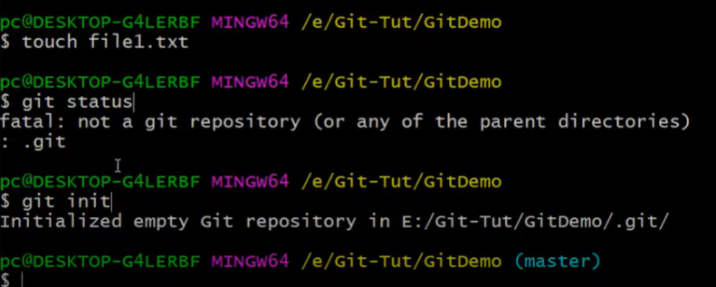
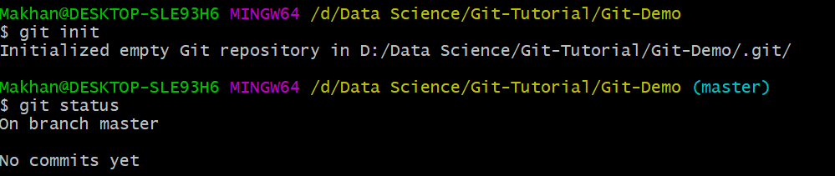

Slide 153
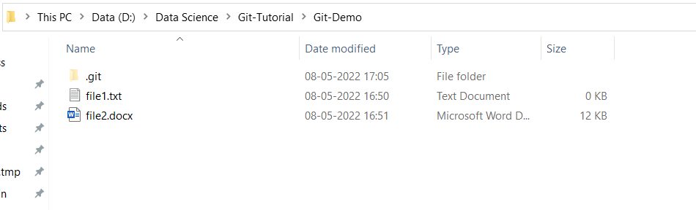

Slide 154
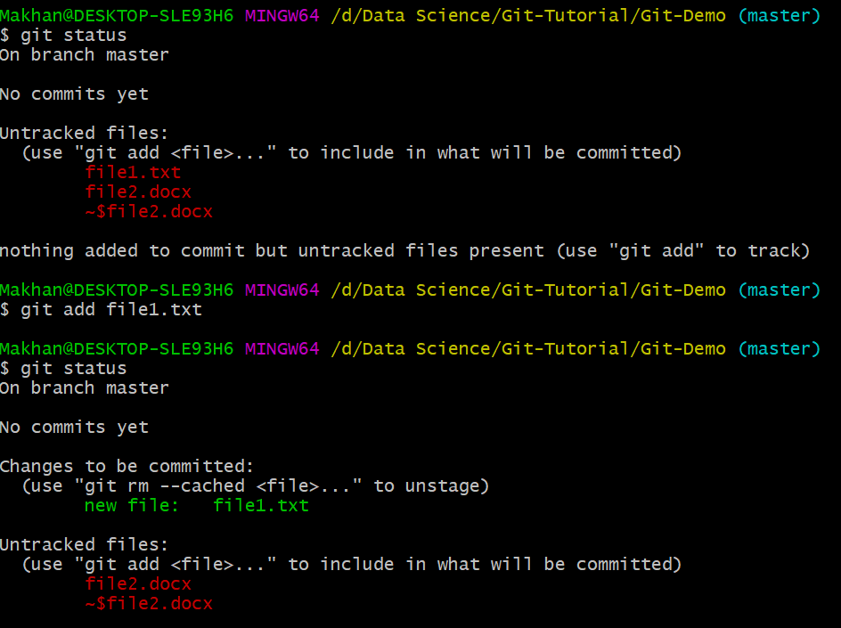

Slide 155
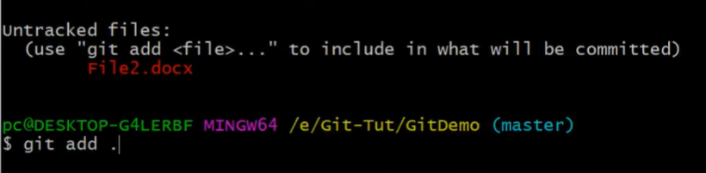
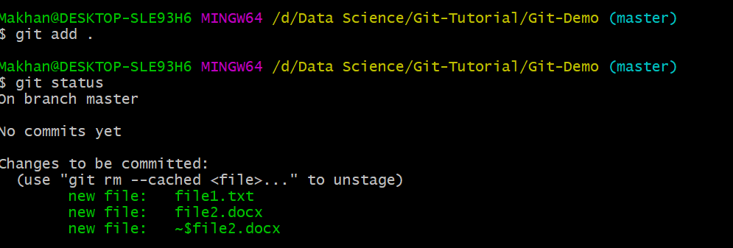
If you want to track all file with one command

Slide 156
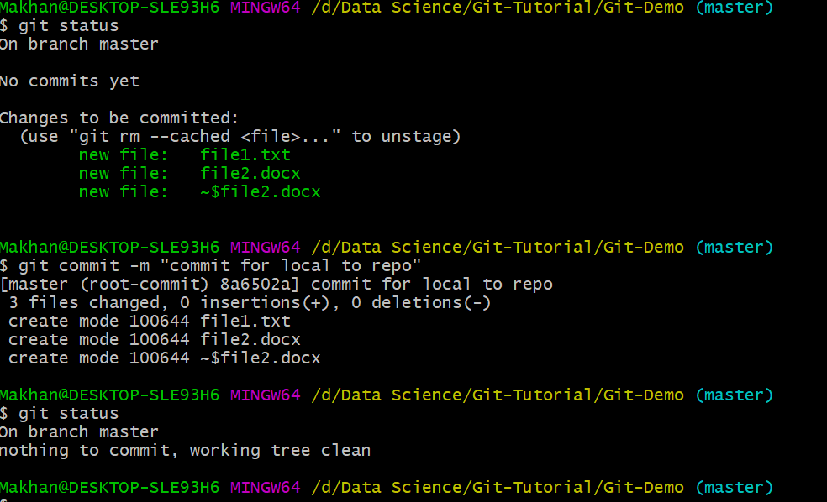

Slide 157
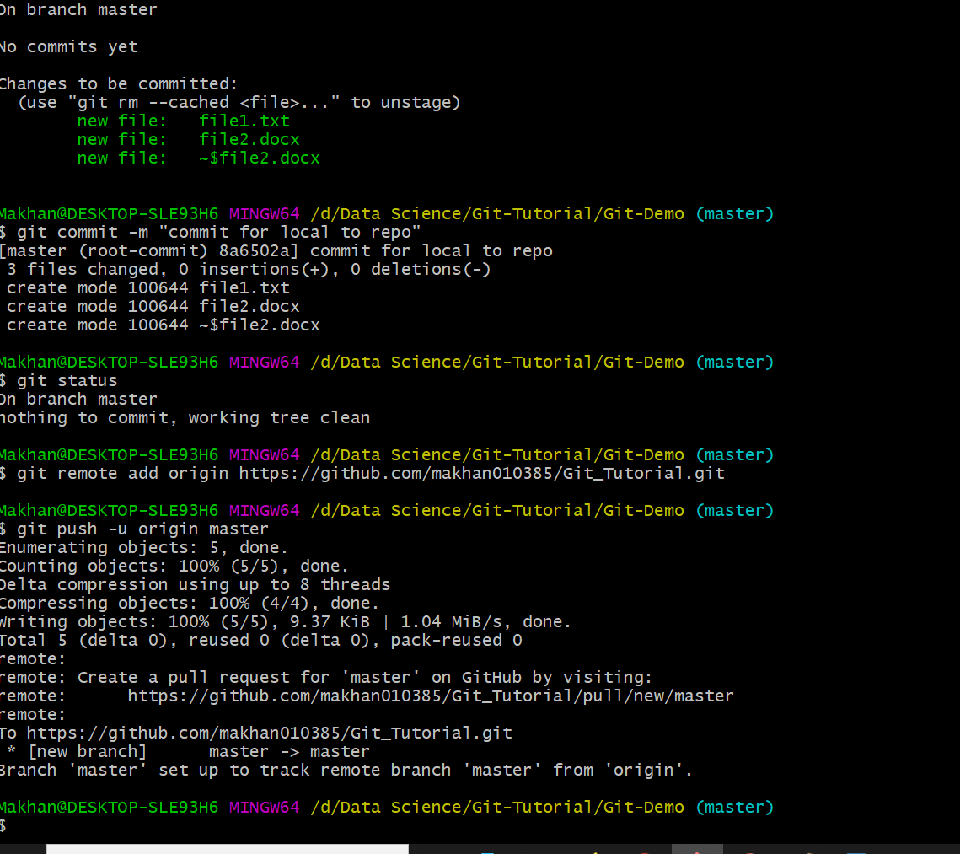

Slide 158
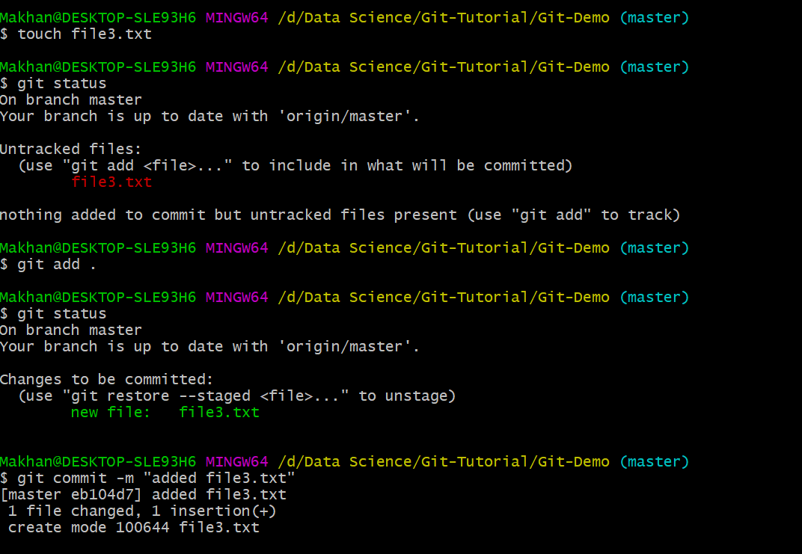
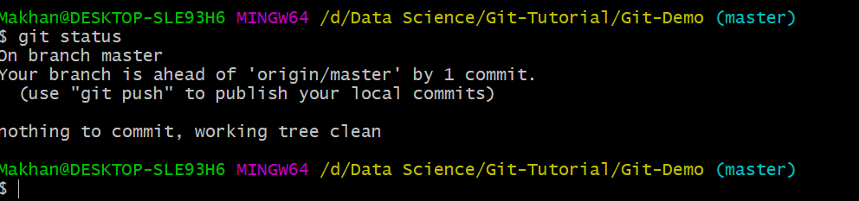

Slide 159
No need to fire remote command like below
Directly fire push command like
git push -u origin master

Slide 160
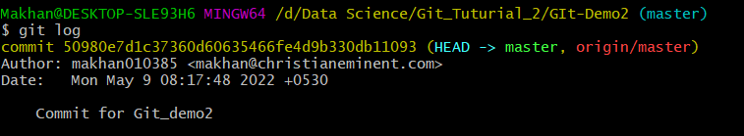
Git log show all Previous commits

Slide 161
How to delete Branch
$ git branch -d bug1
Deleted branch bug1 (was 37c4b3b).

Slide 163
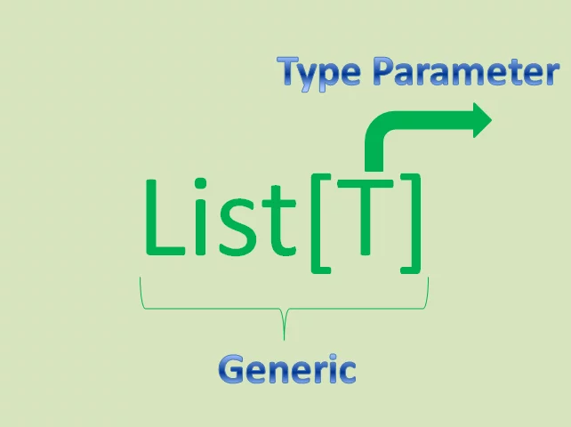
What is Variance?
Variance defines Inheritance relationships of Parameterized Types. Variance is all about Sub-Typing.
Please go through the following image to understand “What is Parameterized Type”.
Here T is known as “Type Parameter” and List[T] is known as Generic.
For List[T], if we use List[Int], List[AnyVal], etc. then these List[Int] and List[AnyVal] are known as “Parameterized Types”

Slide 164
Variance defines Inheritance relationship between these Parameterized Types.
Advantage of Variance in Scala
The main advantage of Scala Variance is:
Variance makes Scala collections more Type-Safe.
Variance gives more flexible development.
Scala Variance gives us a technique to develop Reliable Applications.
Types of Variance in Scala
Scala supports the following three kinds of Variance.
Covariant
Invariant
Contravariant
We will discuss these three variances in detail in coming sections.
Covariant in Scala
If “S” is subtype of “T” then List[S] is is a subtype of List[T].

Slide 165
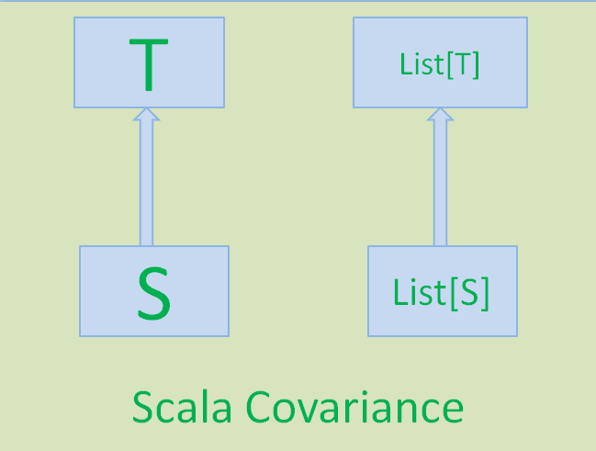
Scala Covariance Syntax:-
To represent Covariance relationship between two Parameterized Types, Scala uses the following syntax:
Prefixing Type Parameter with “+” symbol defines Covariance in Scala.

Slide 166
Example:-
Write a Scala program to demo Scala Covariant SubTyping technique.
class Animal[+T](val animial:T)
class Dog
class Puppy extends Dog
class AnimalCarer(val dog:Animal[Dog])
object ScalaCovarianceTest{
def main(args: Array[String])
{
val puppy = new Puppy
val dog = new Dog
val puppyAnimal:Animal[Puppy] = new Animal[Puppy](puppy)
val dogAnimal:Animal[Dog] = new Animal[Dog](dog)
val dogCarer = new AnimalCarer(dogAnimal)
val puppyCarer = new AnimalCarer(puppyAnimal)
println("Done.")
}
}

